Slide 1
Open Source Modeling Tool Support
Satish Patel
Dan Dumitru

Slide 2
Open Source Tool Support Requirements for SDK v4.0
Perform code generation based on XMI from an open source modeling tool, as well as Enterprise Architect.
Support roundtrip import of the XMI file back into the modeling tool.

Slide 3
Stakeholders
SIW
caAdapter
UML Loader
caCORE SDK

Slide 4
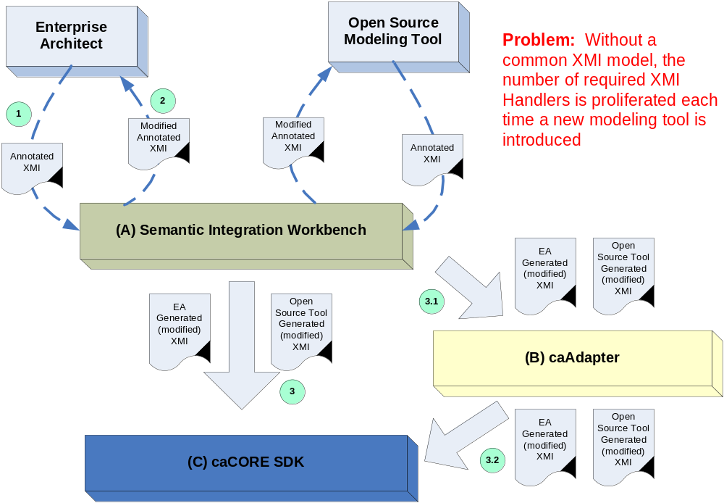
Initial Design for the Support of Additional Modeling Tools

Slide 5
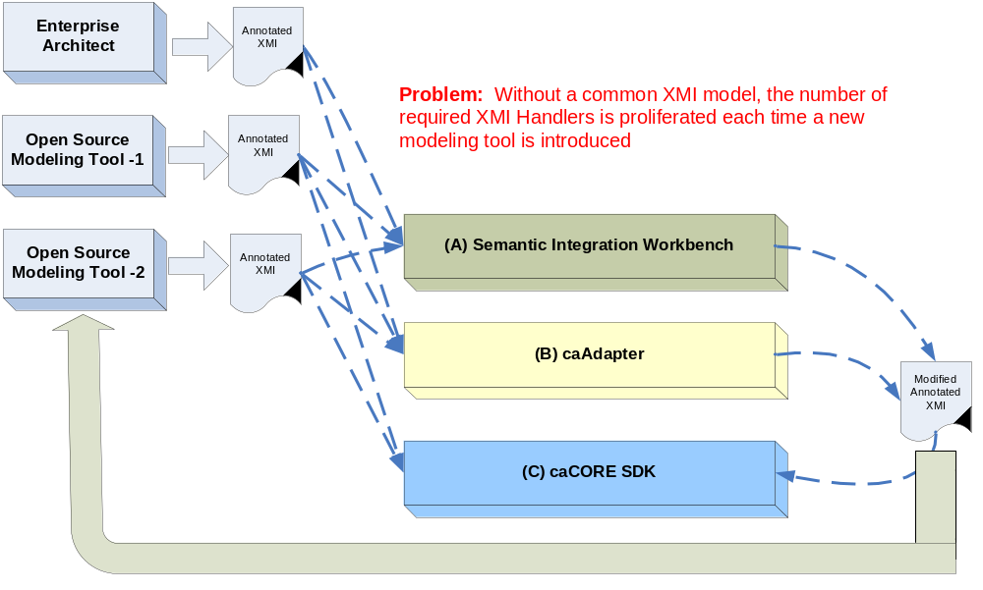
Initial Design for the Support of Additional Modeling Tools

Slide 6
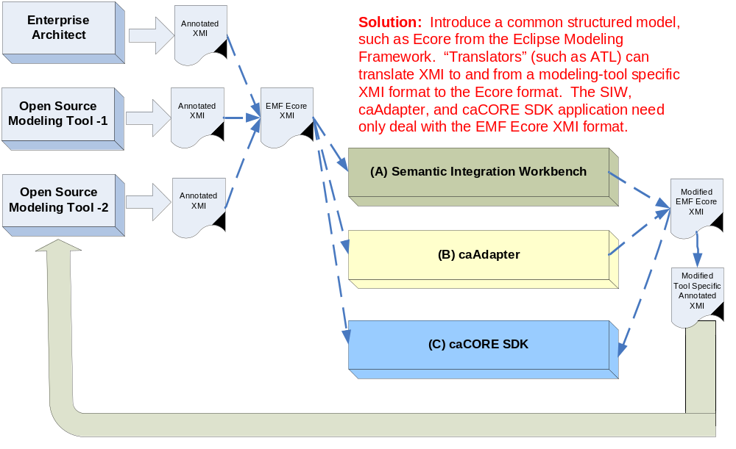
Modified Design for the Support of Additional Modeling Tools

Slide 7
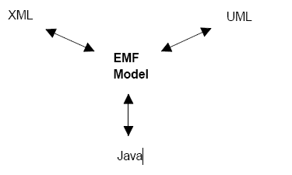
What is EMF? An Overview
The Eclipse Modeling Framework (EMF)
  Framework and code generation facility
  Define a model in XML, UML, or Annotated Java
  Common high-level representation

Slide 8
Why Use EMF?
Sun has dropped support for further development of MDR
There isn't a JSR for a JMI to support XMI 2.0
EMF is the defacto standard for UML 2.0
Many open source tools are migrating to EMF
  openArchitectureWare
  AndroMDA
  ArgoUML

Slide 9
Additional Benefits of Using EMF
Reflective API for manipulating EMF objects
Model change notification
Foundation for interoperability with other EMF-based tools and applications.

Slide 10
Ecore: The EMF Model
Class Diagram subset of UML
A simple model of the classes of the application.
The model used to represent models in EMF is called Ecore, which is itself an EMF model, and thus is its own metamodel.

Slide 11
Use of EMF within NCICB
Focus on leveraging EMF’s Ecore structured model as a single, common standard supported by the various applications
Eliminate having to support a myriad and disparate set of annotated XMI formats
Translators can be used to translate to and from this standard

Slide 12
EMF Interoperable Modeling Tools
ArgoUML: Support for all standard UML 1.4 diagrams
  Argo2Ecore: Converts ArgoUML models to Ecore
Eclipse UML2: EMF based implementation for Eclipse
Omondo EclipseUML
Atlas Transformation Lanuage (ATL)
  OMG standard for performing Model Transformations
  Transform Ecore XMI to a specific model tool XMI format
UML2: An EMF-based implementation for the Eclipse

Slide 13
Next Steps
Prototype EMF based code generation
Demonstrate round-trip with EA

Slide 14

Questions????

